Slide 1

Chapter
18
Oligopoly
Notes:
The first two slides are from the preceding chapter (Monopolistic Competition): concentration ratio and the four main market structures.
Students find this chapter to be of average difficulty. Some students, however, have a little extra trouble with the simple game theory concepts introduced in the chapter, such as understanding how to read a payoff matrix. I’ve included extra examples and an Active Learning exercise on this material, and there are more good exercises among the end-of-chapter problems and study guide.
One of the extra examples in this PowerPoint chapter is a prisoners’ dilemma example in which two candidates agree not to run TV ads attacking each other (the best outcome for society). Self-interest leads to a Nash equilibrium in which each candidate reneges (the worst outcome for society).

Slide 2
IN THIS CHAPTER
What outcomes are possible under oligopoly?
Why is it difficult for oligopoly firms to cooperate?
How can we use game theory to analyze the economics of cooperation?
How are antitrust laws used to foster competition?
Notes:
Here are the main sections in this chapter:
Markets with Only a Few Sellers
The Economics of Cooperation
Public Policy toward Oligopolies
Conclusion

Slide 3
Review
Concentration ratio
Measure a market’s domination by a small number of firms
The percentage of total output in the market supplied by the four largest firms
Less than 50% for most industries
Greater than 90% in: aircraft manufacturing, tobacco, passenger car rentals, and express delivery services
Notes:
The industries with a 4-firm concentration ratio grater than 90% are best described as oligopolies.

Slide 4
Review: the Four Types of Market Structure
Number of firms?
Many firms
One
firm
Type of products?
Identical
products
Differentiated
products
Few
firms
Monopolistic
Competition
Novels
Movies
Perfect
Competition
Wheat
Milk
Monopoly
Tap water
Cable TV
Oligopoly
Tennis balls
Cigarettes
Notes:
This is figure 1 from the previous chapter. It helps students better understand why not only the number of firms in a market is important, but also the type of goods produced.

Slide 5
Oligopoly
Oligopoly
Market structure in which only a few sellers offer similar or identical products
Strategic behavior in oligopoly:
A firm’s decisions about P or Q can affect other firms and cause them to react
The firm will consider these reactions when making decisions
Game theory: the study of how people behave in strategic situations
Notes:
In an oligopoly market, because there are only a few sellers, the actions of any one seller in the market can have a large impact on the profits of all the other sellers: interdependence. Game theory helps explain the strategies that people choose.

Slide 6
Markets with Only a Few Sellers
Oligopolists
Make the most profit when they cooperate and together act like one big monopolist
Strong incentives hinder a group of firms from maintaining the cooperative outcome
Duopoly
A market with only two sellers
Simplest type of oligopoly
Notes:
Key feature in oligopoly markets: the tension between cooperation and self-interest.

Slide 7
EXAMPLE 1: Gas Station Duopoly in Smallville – 1
P | Q
$0 | 10,000
1 | 9,200
2 | 8,400
3 | 7,600
4 | 6,800
5 | 6,000
6 | 5,200
7 | 4,400
8 | 3,600
9 | 2,800
The table: Smallville’s demand schedule for gasoline
Smallville has only two gas stations: 7-eleven and Casey’s (Duopoly)
Q: gallons of gasoline
Each firm’s costs are
MC = $1 and FC = $0
Notes:
Here we have the demand schedule for gasoline in Smallville, a town with only 2 gas stations and far away from other towns.
The FC = 0 assumption: it makes the math easier. (Also, fixed costs are sunk costs and do not affect decisions or outcomes).
MC = $1 per gallon, provides a more complicated example than the one in the textbook (water, and MC = 0)
We will use this example to figure out the competitive outcome, the monopoly outcome, then later on the colluding outcome and the duopoly outcome.

Slide 8
EXAMPLE 1: Smallville, Competition vs. Monopoly – 2
P | Q | Revenue | Cost | Profit
$0 | 10,000
1 | 9,200
2 | 8,400
3 | 7,600
4 | 6,800
5 | 6,000
6 | 5,200
7 | 4,400
8 | 3,600
9 | 2,800
Competitive outcome:
P = MC = $1
Q = 9,200
Profit = $0
$0
9,200
16,800
22,800
27,200
30,000
31,200
30,800
28,800
25,200
$10,000
9,200
8,400
7,600
6,800
6,000
5,200
4,400
3,600
2,800
-$10,000
0
8,400
15,200
20,400
24,000
26,000
26,400
25,200
22,400
Monopoly outcome:
P = $7
Q = 4,400
Profit = $26,400
Notes:
Give your students a few minutes to try and figure out how fill in the revenue, cost, and profit columns. Then, remind them of the following:
Revenue TR = P×Q;
Cost TC = FC + VC, but FC = 0 and MC = $1, so AVC = $1 and constant, therefore TC = Q×AVC = Q×$1.
Profit = TR – TC.
Before considering possible duopoly outcomes, we first review the competitive and monopoly outcomes.
Competitive outcome: P = MC = $1 (from previous slide: we are assuming MC is constant at $1/gallon). At P = $1, market demand equals 9,200 gallons, which the two firms split. Economic profit is zero in perfect competition.
Monopoly outcome: A single firm would produce the quantity where economic profit is maximized. In this example, max profit is $26,400 when Q = 4,400. The firm would set P = $7, from the demand curve, and the firm will maximize profit = $26,400.

Slide 9
Collusion
Collusion:
Agreement among firms in a market about quantities to produce or prices to charge
One possible duopoly outcome
Cartel:
A group of firms acting in unison
Once a cartel is formed, the market is in effect served by a monopoly
Notes:
A cartel must agree not only on total production but also on the amount produced by each member. Each wants a larger share of the market because that means more individual profit…. Each cartel member has an incentive to cheat on cooperation agreements.

Slide 10
Active Learning 1: Collusion in Smallvile?
P | Q
$0 | 10,000
1 | 9,200
2 | 8,400
3 | 7,600
4 | 6,800
5 | 6,000
6 | 5,200
7 | 4,400
8 | 3,600
9 | 2,800
Duopoly outcome with collusion: Each gas station agrees to sell Q = 2,200 at P = $7, each earns profit = $13,200
If Casey’s cheats on the agreement and plans to sell Q = 3,000, what happens to the market price? Calculate Casey’s profit.
Is it in Casey’s interest to cheat on the agreement?
If both gas stations cheat and plan to sell Q = 3,000 each, calculate their profits.
Notes:
You can replace “cheat” with “renege.” Give your students a few minutes to formulate their answers. Remind them that the two firms still face the market demand given in the table, FC = 0 and MC = $1.
Duopoly outcome with collusion: the two firms act as a monopoly, selling a total Q = 4,400 at P = $7, making $26,400 overall in profit (we reached this conclusion in Example 1). Successful collusion means the two firms agree to act as a monopoly to maximize their profits. They equally split the market so Q₁ = Q₂ = 2,200, P = $7, and they split profits Profit₁ = Profit₂ = 26400/2 = $13,200 .
This exercise leads students to discover that each firm has an incentive to cheat on the agreement, causing a breakdown of the profit-maximizing cartel outcome.
“Cheat on the agreement” means cheat on the agreement to collude to restrict the Q and receive higher P (act as a monopoly).

Slide 11
Active Learning 1: Answers
P | Q
$0 | 10,000
1 | 9,200
2 | 8,400
3 | 7,600
4 | 6,800
5 | 6,000
6 | 5,200
7 | 4,400
8 | 3,600
9 | 2,800
If both stick to the agreement, each earns profit = $13,200
A. If Casey’s cheats: Q₁ = 3,000
Market quantity = 3,000 + 2,200 = 5,200
P = $6
Casey’s profit = 3,000×(6 – 1) = $15,000
B. Yes. Higher profit!
C. If both cheat: Q₁ = Q₂ = 3,000
Market quantity = 6,000
P = $5
Each firm’s profit = 3,000×(5-1) = $12,000
Notes:
Duopoly colluding: Q₁ = Q₂ = 2,200, P = $7, Profit ₁ = Profit ₂ = $13,200
Remember that we have the demand schedule for Smallville, so if we know the Q, the price will be determined by the demand schedule.
Remember that because FC = 0, TC = AVC*Q. And because MC = 1, then AVC = 1.
Calculating Casey’s profit = TR – TC = P*Q – AVC*Q = Q*(P – MC) = 15,000
You could take this a step further and calculate 7-eleven’s profit when only Casey’s cheats on the agreement (since we’ll need it for the Prisoners’ dilemma later on Example 3) = 2,200*(6-1) = $11,000
Note that profit for Casey’s + profit for 7-eleven = 15,000 + 11,000 = 26,000 = the market profit for a total Q = 5,200 (we calculated the profit in Example 1B)
B. Casey’s earns $13,200 if they stick to the agreement, but earns $15,000 if they cheat.
C. Because the total market quantity is 6,000, we look at the demand schedule to find P = $5. Another way to calculate each firm’s profit is half of market profit from Example 1B (since both produce the same quantity and have the same costs).

Slide 12
Collusion vs. Self-Interest
Both firms would be better off if both stick to the collusion agreement (form a cartel)
But each firm has incentive to cheat on the agreement.
Lesson:
It is difficult for oligopoly firms to form cartels and honor their agreements.

Slide 13
Active Learning 2: Duopoly equilibrium in Smallville
P | Q
$0 | 10,000
1 | 9,200
2 | 8,400
3 | 7,600
4 | 6,800
5 | 6,000
6 | 5,200
7 | 4,400
8 | 3,600
9 | 2,800
FC = 0 and MC = $1.
If each firm sells Q = 3,000,
P = $5, and each firm’s profit is $12,000
Should Casey’s increase Q to 3,800?
Should 7-eleven increase Q to 3,800?
Notes:
Give your students a few minutes to figure out the answers. This exercise shows students that each firm selling Q = 3000 is the equilibrium.
In the previous exercise (Active learning 1), students were instructed to find the new market price—an important intermediate step—before determining the effect on profit. In this exercise, the instructions do not ask students to determine the effect on market price. The intention is to see if they will remember to do this critical intermediate step themselves.

Slide 14
Active Learning 2: Answers
P | Q
$0 | 10,000
1 | 9,200
2 | 8,400
3 | 7,600
4 | 6,800
5 | 6,000
6 | 5,200
7 | 4,400
8 | 3,600
9 | 2,800
If each firm sells Q = 3,000, P = $5, and each firm’s profit = $12,000.
FC = 0 and MC = $1.
If Casey’s increases Q to 3,800:
Market Q = 6,800, P = $4
Casey’s profit = 3,800×(4–1) = $11,400
Casey’s earns a lower profit at Q = 3,800 than at Q = 3,000
The same is true for 7-eleven.
Notes:
Aha! Each firm producing Q = 3,000 (cheating on the agreement to collude) is the equilibrium for this duopoly! This is the Nash equilibrium defined on the next slide.

Slide 15
The Equilibrium for an Oligopoly
Nash equilibrium
Economic actors interacting with one another, each choose their best strategy
Given the strategies that all the other actors have chosen
When firms in an oligopoly individually choose production to maximize profit
Produce Q: greater than monopoly Q, less than competitive Q
The price: is less than the monopoly P, greater than the competitive P = MC
Notes:
Our duopoly example (Smallville) has one Nash equilibrium:
Given that Casey’s sells Q = 3,000, 7-eleven’s best move is to sell Q = 3,000
Given that 7-eleven’s sells Q = 3,000, Casey’s best move is to sell Q = 3,000
Demonstrates that the non-cooperative oligopoly outcome falls in between the monopoly and competitive outcomes.

Slide 16
The Output & Price Effects
Increasing output has two effects on a firm’s profits:
Output effect: because P > MC, increasing output raises profits
Price effect: raising production increases total quantity sold, which reduces price and reduces profit on all units sold
Notes:
If output effect > price effect, the firm increases production.
If price effect > output effect, the firm reduces production.
Each oligopolist increases production until these two marginal effects exactly balance, taking the other firms’ production as given.

Slide 17
The Size of an Oligopoly
As the number of sellers in an oligopoly increases:
The price effect becomes smaller
The oligopoly looks more and more like a competitive market
The price approaches marginal cost
The market quantity approaches the socially efficient quantity
Another benefit of international trade
Notes:
Suppose the U.S., Germany, and Japan each have two automakers:
* Ford and GM in the U.S.
* BMW and Mercedes in Germany
* Honda and Toyota in Japan
Without international trade in autos, each country has a duopoly.
With international trade, the number of sellers competing with each other increases to six, which drives prices down toward marginal cost and increases the market quantity toward the socially efficient quantity.

Slide 18
Market Share and Market Power
“If a small number of firms have a large combined market share in a properly defined market, it is strong evidence that those firms have substantial market power.”
Notes:
This “Ask the Experts” feature provides the opportunity for class discussion.
After showing the statement, you can ask your students to choose one of the options: agree, disagree, or uncertain. You can collect their answers in a variety of ways: show of hands, ballot, clicker system, etc. If time permits, you can allow students to group and discuss some of the reasons they chose their answer.
Ask the students to share with the class their reasons. Their answers will vary.

Slide 19
The Economics of Cooperation
The Prisoners’ Dilemma
Particular “game” between two captured prisoners
Illustrates why cooperation is difficult to maintain even when it is mutually beneficial
Dominant strategy
Strategy that is best for a player in a game
Regardless of the strategies chosen by the other players
Notes:
Game theory helps us understand oligopoly and other situations where “players” interact and behave strategically.
A “game” is a situation in which players interact.
The term “payoff matrix” is fairly standard in microeconomics, so it may be worth mentioning to your students. However, the textbook only uses this term in the problems and application section.
There are three elements to a game; and all of these elements are represented in the payoff matrix:
“Players” can be people, firms, countries, or other entities.
A “strategy” is a decision or decision-plan chosen by a player, which takes into account the behavior and likely reactions of other players.
Payoffs are the reward (profit, revenue, winning) or punishment (years in jail) for choosing a specific strategy. The payoffs for a player depend not only on the strategy chosen, but also on what the other player does (strategic interaction).

Slide 20
EXAMPLE 2: The Prisoners’ Dilemma – 1
The police have caught Bonnie and Clyde, two suspected bank robbers, but only have enough evidence to imprison each for 1 year.
The police question each in separate rooms, offer each the following deal:
If you confess and implicate your partner, you go free.
If you do not confess but your partner implicates you, you get 20 years in prison.
If you both confess, each gets 8 years in prison.
Notes:
This is the example discussed in the textbook.
SUGGESTION: Instead of showing this slide, ask for two volunteers to be your prisoners. You should pick two students that sit in different parts of the classroom, who are less likely to know each other. Tell them they will be playing bank robbers who have been caught. You are going to interrogate each one separately, like they do on police dramas.
Ask Student #2 to step out of the room for a few moments. Offer to Student #1 the deal described on this slide. Make a note of his or her choice, but do not write it on the board. (Remind all the other students that they are witnesses on the other side of the one-way mirror.)
Have Student #2 step into the room, and ask Student #1 to wait outside. Offer to Student #2 the deal described on this slide. Ask the class not to give any hints about the decision that Student #1 made. Make a note of Student #2’s choice.
Invite Student #1 back into the room. Write down both of their choices on the board and reveal to each of them their fate.
Hopefully, each student plays the “confess” strategy, so that the outcome of this role-play is the classic Prisoner’s Dilemma Nash Equilibrium. But even if the outcome is different, that’s okay. Ask each student to give the reasons for the strategy they chose. Explain why you would have expected both to play the “confess” strategy, and show the payoff matrix on the next slide.
I’m telling you, students LOVE this. It takes a little longer to get through the material, but the material has much more impact then merely lecturing on the Bonnie and Clyde example.

Slide 21
EXAMPLE 2: The Prisoners’ Dilemma – 2
0
Confessing is the dominant strategy for both players.
Bonnie’s decision
Nash equilibrium: both confess
Confess
Remain silent
Bonnie gets 8 years
Bonnie gets 20 years
Confess
Clyde gets 8 years
Clyde goes free
Clyde’s decision
Bonnie goes free
Bonnie gets 1 year
Remain silent
Clyde gets 20 years
Clyde gets 1 year
Notes:
21
Game theory reminders: in any cell, the payoff/number on the left belongs to the player on the left (and the payoff/number on the right belongs to the other player)
This slide is animated carefully as follows:
1) What should Bonnie do? If Clyde confesses, then Bonnie gets 8 years if she confesses or 20 years if she does not.
2) What should Bonnie do? If Clyde remains silent, Bonnie goes free if she confesses or gets 1 year if she does not.
At this point, it may be worth mentioning that Bonnie’s best move is to confess, regardless of Clyde’s decision—hence, “confess” is Bonnie’s dominant strategy.
3) What should Clyde do? If Bonnie confesses, Clyde gets 8 years if he confesses or 20 years if he does not.
4) What should Clyde do? If Bonnie remains silent, Clyde goes free if he confesses or gets 1 year if he does not.
Regardless of Bonnie’s decision, Clyde’s best move is to confess. Both players have a dominant strategy of confessing.

Slide 22
EXAMPLE 2: The Prisoners’ Dilemma – 3
0
Outcome of the game: Bonnie and Clyde both confess, each gets 8 years in prison.
Both would have been better off if both remained silent.
But even if Bonnie and Clyde had agreed before being caught to remain silent, the logic of self-interest takes over and leads them to confess.
Notes:
22
The prisoners’ dilemma illustrates why cooperation is so difficult even when it is in both players’ mutual interest.

Slide 23
Oligopolies as a Prisoners’ Dilemma
When oligopolies form a cartel
Hoping to reach the monopoly outcome, they become players in a prisoners’ dilemma
The monopoly outcome is jointly rational, but each firm has an incentive to cheat: self-interest makes it hard to maintain the cooperative outcome with low production, high prices, and monopoly profits
Notes:
Our earlier duopoly example (collusion in Smallville, Active Learning 1):
Casey’s and 7-eleven are duopolists in Smallville
The cartel outcome (collusion) maximizes profits: each firm agrees to sell Q = 2,200 gallons of gasoline, each makes $13,200 in profit
But both have an incentive to cheat on that agreement and we end up with a Nash equilibrium where each sells Q = 3,000 gallons, and each makes only $12,000 in profit.
(If one sold Q₁ = 2,200 and the other Q₂ = 3,000, the one cheating and selling 3,000 gallons would make $15,000 in profit, while the one selling the 2, 200 gallons would make only $11,000)
Since the Smallville example we solved so far has every information your students need, you can break the lecture and ask them to work in pairs and build the payoff matrix, fill it in with the profits, and find the Nash equilibrium (of course, it will be the same as the duopoly outcome: both cheat on the agreement to collude!)

Slide 24
EXAMPLE 3: Casey’s and 7-eleven: Prisoners’ Dilemma
0
Each firm’s dominant strategy: cheat and produce Q = 3,000.
7-eleven
Collude Q = 2,200
Cheat Q = 3,000
7-eleven’s profit = $13,200
7-eleven’s profit = $15,000
Collude
Q = 2,200
Casey’s profit = $13,200
Casey’s profit = $11,000
Casey’s
7-eleven’s profit = $11,000
7-eleven’s profit = $12,000
Cheat
Q = 3,000
Casey’s profit = $15,000
Casey’s profit = $12,000
Notes:
24
In this exercise, students have to identify dominant strategies and the Nash equilibrium.
The payoff matrix is already filled.
Remind your students that we stuck a player in a decision to see what’s the best response for the other player.
For example, if 7-eleven produces the small quantity (stick to the agreement to collude), then Casey’s will earn $13,200 profit if agree to collude, but earn $15,000 profit if they cheat. So, Casey’s will be better off selling 3,000.
If 7-eleven cheats and produces 3,000, then Casey’s will earn $11,000 profit if collude, but earn $12,000 if they cheat. So, Casey’s will be better off selling 3,000, regardless of how much gasoline 70eleven is selling.
The analysis is similar for 7-eleven. (If Casey’s chooses one strategy, what should 7-eleven do?)
Each player has a dominant strategy: cheat on the agreement and produce 3,000; and both producing 3,000 gallons is the Nash equilibrium.

Slide 25
Other examples of the prisoners’ dilemma – 1
Ad Wars
Two firms spend millions on TV ads to steal business from each other.
Each firm’s ad cancels out the effects of the other, and both firms’ profits fall by the cost of the ads.
Organization of Petroleum Exporting Countries
Member countries try to act like a cartel, agree to limit oil production to boost prices and profits.
But agreements sometimes break down when individual countries renege.
Notes:
The first example, “ad wars,” is not mentioned in the textbook.
An interesting note about ad wars: When Congress banned cigarette advertising on television in 1971, cigarette manufacturers’ profits rose. Prior to the ban, cigarette companies were stuck in a Nash equilibrium (with lower profits) in which all were spending heavily on TV ads to steal business from each other. The ban, in effect, forced cigarette manufacturers to switch to the cooperative outcome in which none advertises on TV and earn high profits.
The OPEC example is discussed in more details in the textbook, in the Case Study: “OPEC and the World Oil Market.”

Slide 26
Other examples of the prisoners’ dilemma – 2
Arms race between military superpowers
Each country would be better off if both disarm, but each has a dominant strategy of arming.
Common resources
All would be better off if everyone conserved common resources, but each person’s dominant strategy is overusing the resources.
Notes:
The Arms-race example is discussed in more details in the textbook, and is accompanied by the payoff matrix in Figure 3. The Common resources example is discussed in much more detail in the textbook, and the Active Learning 3 exercise coming up .
Instead of covering these same examples in detail in this PowerPoint, we look at different examples, so that students who read the book still have a reason to attend class (and vice versa). However, it’s still useful to mention the book’s examples here, and briefly discuss them if you wish, so they will be familiar to students when students read the chapter.

Slide 27
Welfare of Society
Noncooperative oligopoly equilibrium
May be bad for oligopolists
Prevents them from achieving monopoly profits
May be bad for society
Examples: Arms race game, Common resource game
May be good for society
Quantity and price – closer to optimal level
Notes:
In the arms race “game,” each of the superpowers would be better off if they could cooperate and sign an agreement to disarm. But the logic of self-interest dictates that each country will arm itself to the teeth. As a result, both countries are worse off for two reasons:
1) The risk of nuclear annihilation is higher.
2) Resources consumed in the arms race could have been used elsewhere.
The following slide presents another example in which the inability to cooperate reduces social welfare.

Slide 28
Active Learning 3: Go fish! On Lake Michigan
Assume there are only two companies that own the entire commercial fishing fleet, The Joy of Fishing and The Singing Fish, and there are no restrictions on commercial fishing on Lake Michigan.
If both choose to catch a small quantity, each earns $300 million profit. If both choose to catch a larger quantity, each earns $250 million profit
If one company chooses to catch a small quantity but the other chooses a large quantity, the one choosing the small quantity earns $150 million, and the other earns $400 million profit
What is the colluding outcome? What is the Nash equilibrium?
Notes:
A company can catch a small quantity if they are sending out the fleet to fish once a year (or just a few vessels). A company can catch a large quantity if they are repeatedly sending out the fleet (or send all the vessels).
When both choose the small quantity, the price will he higher than when both choose the large quantity (downward sloping market demand).
Give your students a few minutes to build the payoff matrix and solve the problem. The answers are on the next slide.

Slide 29
Active Learning 3: Answers
Colluding outcome: both catch a small quantity.
The Singing Fish
Small Q
Large Q
$ 300 mill
$400 mill
Small Q
$300 mill
$150 mill
The Joy of Fishing
$150 mill
$ 250 mill
Large Q
$400 mill
$250 mill
Nash equilibrium
Notes:
Each company’s dominant strategy: catch the large quantity of fish.
The following slide presents another example in which the inability to cooperate reduces social welfare.

Slide 30
EXAMPLE 4: Negative campaign ads – 1
Election with two candidates, “R” and “D.”
If R runs a negative ad attacking D, 3,000 fewer people will vote for D (1,000 of these people vote for R, the rest abstain).
If D runs a negative ad attacking R, R loses 3,000 votes, D gains 1,000, 2,000 abstain.
R and D agree to refrain from running attack ads. Will each of them stick to the agreement?
Notes:
30
Example 4 (this slide and the two that follow) works through an example that is especially topical during election years. It does not appear in the textbook, so it is not supported with Test Bank questions or Study Guide questions. Please feel free to omit it from your presentation.
Yet, I encourage you to consider keeping this example. Students find it interesting: it explains why negative ads flood the airwaves prior to elections, and it explains the effects of these ads on society.

Slide 31
EXAMPLE 4: Negative campaign ads – 2
0
Each candidate’s dominant strategy: run attack ads.
R’s decision
Do not run attack ads (cooperate)
Run attack ads (defect)
no votes lost or gained
R gains 1,000 votes
Do not run attack ads (cooperate)
no votes lost or gained
D loses 3,000 votes
D’s decision
R loses 3,000 votes
R loses 2,000 votes
Run attack ads (defect)
D gains 1,000 votes
D loses 2,000 votes
Notes:
31
Understanding the payoffs:
Mutual cooperation is the benchmark outcome: Payoffs in other cells are differences in votes received relative to the mutual cooperation outcome. (This does not mean that there is a tie in the mutual cooperation outcome or the mutual defection outcome. It means that the winner will be decided by factors other than whether attack ads run or not.)
Consider R’s decision. R is better off defecting (running ads attacking D) whether D cooperates or defects. If D cooperates, R’s attack ads result in 1,000 more votes for R and 3,000 fewer votes for D. If D defects, R loses fewer votes if he runs the attack ad than if he cooperates. Hence, running attack ads is a dominant strategy for R.
The payoffs here are symmetric, so defecting is also D’s dominant strategy. This game has a Nash equilibrium in which both candidates defect. This is one reason why, in the real world, we see so many attack ads in the weeks leading up to an election.

Slide 32
EXAMPLE 4: Negative campaign ads – 3
Nash equilibrium
Both candidates run attack ads.
Effects on election outcome: NONE
Each side’s ads cancel out the effects of the other side’s ads.
Effects on society: NEGATIVE
Lower voter turnout, higher apathy about politics, less voter scrutiny of elected officials’ actions.
Notes:
32
This slide considers the effects of the attack ads on election outcomes and on social well-being. The negative impact on social well-being is like a negative externality: the “bystanders” are voters who are worse off as a result of the candidates’ actions.

Slide 33
Why People Sometimes Cooperate
When the game is repeated many times, cooperation may be possible
Two strategies may lead to cooperation:
If your rival reneges in one round, you renege in all subsequent rounds.
“Tit-for-tat” Whatever your rival does in one round (whether renege or cooperate), you do in the following round.
Notes:
The case study from the textbook: “The Prisoners” Dilemma Tournament” offers a more detailed analysis.

Slide 34
Public Policy Toward Oligopolies
Governments can sometimes improve market outcomes.
Policymakers
Try to induce firms in an oligopoly to compete rather than cooperate
Move the allocation of resources closer to the social optimum
Notes:
The first bullet point is one of the 10 principles we studied in Chapter 1.
Because in oligopolies production is too low and prices are too high relative to the social optimum, we need government interference to improve the outcome.

Slide 35
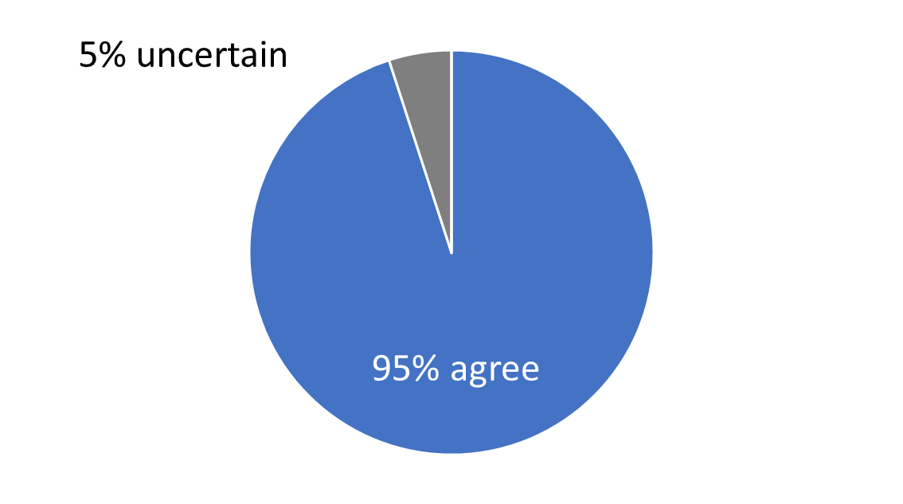
Antitrust in the Digital Economy
“Google's dominance of the market for internet search arose mainly from a combination of economies of scale and a quality algorithm.”
Source: IGM Economic Experts Panel, November 3, 2020, December 22, 2020.
Notes:
This “Ask the Experts” feature provides the opportunity for class discussion. (there are 4 questions about the Antitrust in the Digital Economy. This is only the first one).
After showing the statement, you can ask your students to choose one of the options: agree, disagree, or uncertain. You can collect their answers in a variety of ways: show of hands, ballot, clicker system, etc. If time permits, you can allow students to group and discuss some of the reasons they chose their answer.
Ask the students to share with the class their reasons. Their answers will vary.

Slide 36
Antitrust Laws
The Sherman Antitrust Act, 1890
Elevated agreements among oligopolists from an unenforceable contract to a criminal conspiracy
The Clayton Act, 1914
Further strengthened the antitrust laws
The laws are used to prevent:
Mergers that would give a firm excessive market power
Oligopolists from acting together in ways that would make their markets less competitive
Notes:
If you’re so inclined, this might be a good place to mention the infamous phone call in which Robert Crandall, CEO of American Airlines, tried to convince Braniff’s CEO Howard Putnam to raise fares 20%. The transcript is in the case study “An Illegal Phone Call.” Students will find it interesting: it has curse words. The Active Learning 4 on the next slide is using the same airline companies.

Slide 37
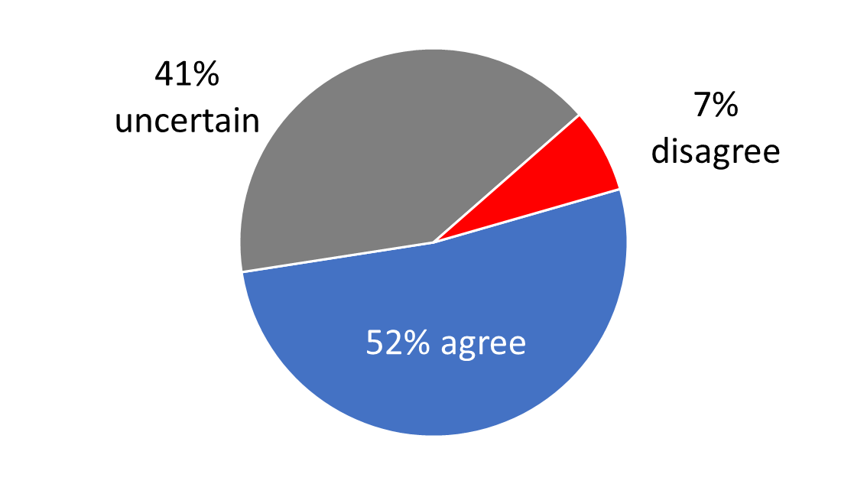
Antitrust in the Digital Economy
“In light of Google’s dominance, its current operating practices could have a substantial negative effect on social welfare in the long run.”
Source: IGM Economic Experts Panel, November 3, 2020, December 22, 2020.
Notes:
This “Ask the Experts” feature provides the opportunity for class discussion. (there are 4 questions about the Antitrust in the Digital Economy. This is the second one).
After showing the statement, you can ask your students to choose one of the options: agree, disagree, or uncertain. You can collect their answers in a variety of ways: show of hands, ballot, clicker system, etc. If time permits, you can allow students to group and discuss some of the reasons they chose their answer.
Ask the students to share with the class their reasons. Their answers will vary.

Slide 38
Active Learning 4: The airline fare wars game
The players: American Airlines and Braniff Airways. The choice: cut fares by 50% or leave fares alone.
If both airlines cut fares, each airline’s profit = $400 million
If neither airline cuts fares, each airline’s profit = $600 million
If only one airline cuts its fares, its profit = $800 million; the other airline’s profit = $200 million
Draw the payoff matrix, find the Nash equilibrium
Notes:
The title I have given this game (the “fare wars” game) might be too much of a hint about what happens in the Nash equilibrium. Feel free to change it to something like “airfare pricing strategies.”
Braniff Airways was a major airline in the early 1980’s.

Slide 39
Active Learning 4: Answers
Nash equilibrium: both firms cut fares
Braniff Airways
Cut fares
Don’t cut fares
$400 million
$200 million
Cut fares
American Airlines
$400 million
$800 million
$800 million
$600 million
Don’t cut fares
$200 million
$600 million

Slide 40
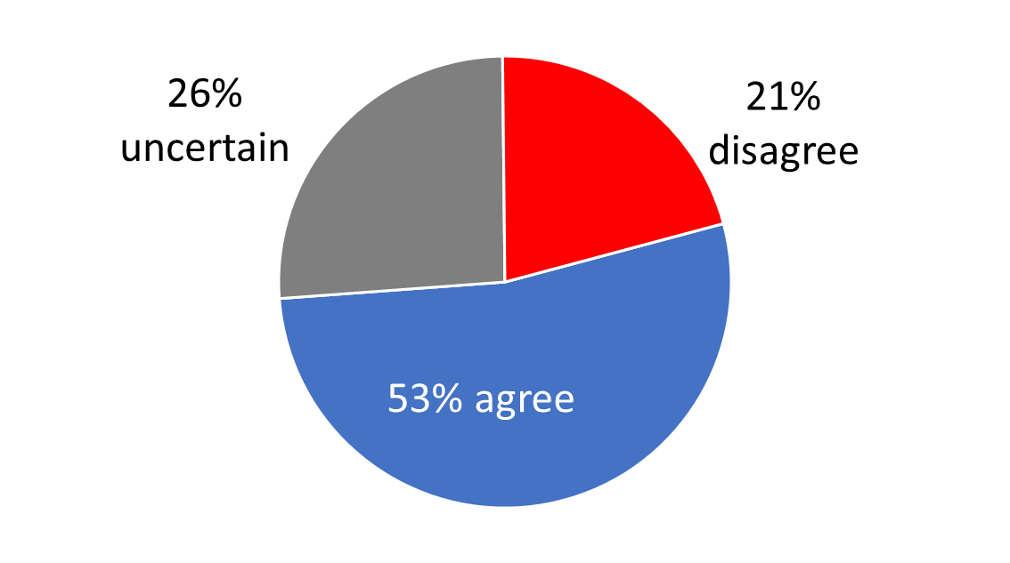
Antitrust in the Digital Economy
“The nature of the market dominance of technology giants in the digital economy warrants either the imposition of some kind of regulation or a fundamental change in antitrust policy.”
Source: IGM Economic Experts Panel, November 3, 2020, December 22, 2020.
Notes:
This “Ask the Experts” feature provides the opportunity for class discussion. (there are 4 questions about the Antitrust in the Digital Economy. This is the third one).
After showing the statement, you can ask your students to choose one of the options: agree, disagree, or uncertain. You can collect their answers in a variety of ways: show of hands, ballot, clicker system, etc. If time permits, you can allow students to group and discuss some of the reasons they chose their answer.
Ask the students to share with the class their reasons. Their answers will vary.

Slide 41
Controversies Over Antitrust Policy
Most commentators agree that price-fixing agreements among competing firms should be illegal.
The antitrust laws have been used to condemn some business practices whose effects are less obvious.
We consider three such practices…

Slide 42
1. Resale Price Maintenance
A manufacturer imposes lower limits on the prices retailers can charge
Often opposed because it appears to reduce competition at the retail level
Yet, any market power the manufacturer has is at the wholesale level
No gains from restricting competition at the retail level
Legitimate goal: preventing discount retailers from free-riding on the services provided by full-service retailers
Notes:
Resale price maintenance is a controversial business practice, yet it has legitimate goals.

Slide 43
2. Predatory Pricing
A firm cuts prices to prevent entry or drive a competitor out of the market
So that it can charge monopoly prices later
Illegal under antitrust laws
Difficult: when a price cut is predatory and when it is competitive & beneficial to consumers?
Economists debate whether predatory pricing should concern antitrust policymakers:
It involves selling at a loss (costly for the firm)
It can backfire
Notes:
Regarding the last two points:
Predatory pricing requires selling products below cost, generating losses. The firm must have deep pockets to sustain such losses and survive until its competitor leaves the market. Afterward, there is no guarantee that the economic profits from charging the monopoly price will make up for the losses sustained during the period of predatory pricing.
Suppose a firm engages in predatory pricing and sustains deep losses for a period of time, but succeeds in driving its competitor out of business. Even then, the pressure is not off—a potential entrant may be standing by, ready to jump into the market to take a share of the monopoly profits the firm would otherwise enjoy all to itself. If so, then the firm is less likely to recover the losses it endures while it is engaging in predatory pricing.
Economists have done a fair amount of research on predatory pricing, and there is not yet any consensus. Until there is, it might not be a good idea to prosecute predatory pricing under the antitrust laws.

Slide 44
3. Bundling
A manufacturer bundles two products together and sells them for one price
Critics
Bundling gives firms more market power by connecting weak products to strong ones
Others: bundling cannot change market power
Buyers are not willing to pay more for two goods together than for the goods separately
Firms may use bundling for price discrimination
Sometimes increases economic efficiency
Notes:
An example of tying: Microsoft including Internet Explorer within Windows (include a browser with its operating system). The details of the Microsoft case are in the last case study in the text.

Slide 45
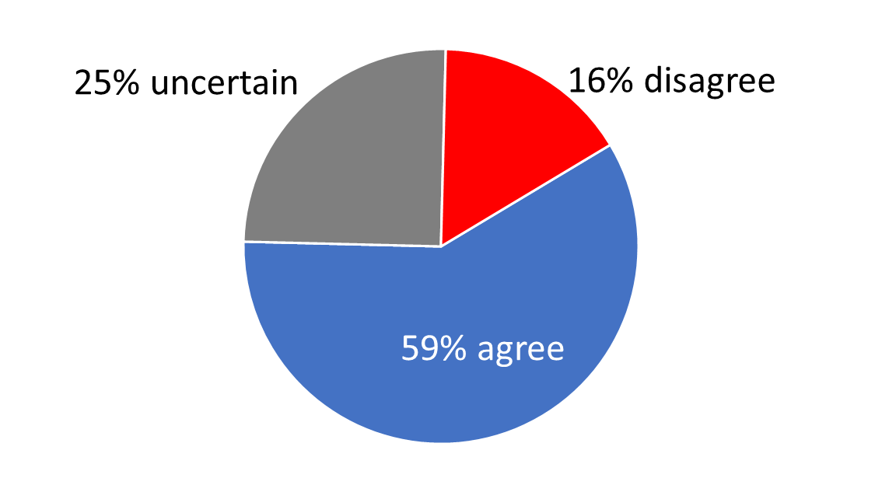
Antitrust in the Digital Economy
“Requiring Facebook to divest WhatsApp and Instagram is likely to make society better off.”
Source: IGM Economic Experts Panel, November 3, 2020, December 22, 2020.
Notes:
This “Ask the Experts” feature provides the opportunity for class discussion. (there are 4 questions about the Antitrust in the Digital Economy. This is the last one).
After showing the statement, you can ask your students to choose one of the options: agree, disagree, or uncertain. You can collect their answers in a variety of ways: show of hands, ballot, clicker system, etc. If time permits, you can allow students to group and discuss some of the reasons they chose their answer.
Ask the students to share with the class their reasons. Their answers will vary.

Slide 46
THINK-PAIR-SHARE
New on campus in a small town, your best friend, Elijah, is amazed that both grocery stores in town are open 24 hours. He says “This is a great idea! Staying open all the time must mean that both stores make lots of profit!”
Since there are only two grocery stores in town, is it likely they make “lots of profit” by staying open 24 hours?
Can you use prisoners’ dilemma to explain why the stores are open 24 hours a day?
Notes:
Suggestion: For the Think-Pair-Share activities, if time allows, allow students to work in small groups for 5-10 minutes. Then allow student groups to share with other groups or with the entire class. Or, you can treat the Think-Pair-Share activity as an open-to-all in–class discussion.
Discussion points:
A. No. It is more likely that both stores (the only ones in town; so, it’s a duopoly) are worse off by staying open 24 hours a day. Even in a college town, the revenue from the few extra customers shopping outside the “usual business hours” is probably lower than the variable cost of keeping the store open (additional security, cashiers, electricity, and so on).
B. The two stores are stuck in a prisoners’ dilemma game where the Nash equilibrium is to stay open 24 hours. They would both be better off (higher profits) if they stay open only during the day (this would be the collusion). But if only one stays open overnight when the other closes overnight, the one staying open will gain all overnight shoppers and that may lead to an increase in profits. So, while each would be better off staying open only during day-time, self-interest dictates that both stay open overnight, a Nash equilibrium that is not what’s best for the group.

Slide 47
CHAPTER IN A NUTSHELL
Oligopolists maximize their total profits by forming a cartel and acting like a monopolist.
Yet, if oligopolists make decisions about production levels individually, the result is a greater quantity and a lower price than under the monopoly outcome.
The larger the number of firms in the oligopoly, the closer the quantity and price will be to the levels that would prevail under perfect competition.

Slide 48
CHAPTER IN A NUTSHELL
The prisoners’ dilemma shows that self-interest can prevent people from maintaining cooperation, even when cooperation is in their mutual interest. The logic of the prisoners’ dilemma applies to many situations, including arms races, common-resource problems, and oligopolies.
Policymakers use the antitrust laws to prevent oligopolies from engaging in behavior that reduces competition. The application of these laws can be controversial because some behavior that can appear to reduce competition may have legitimate business purposes.

